Slide 1
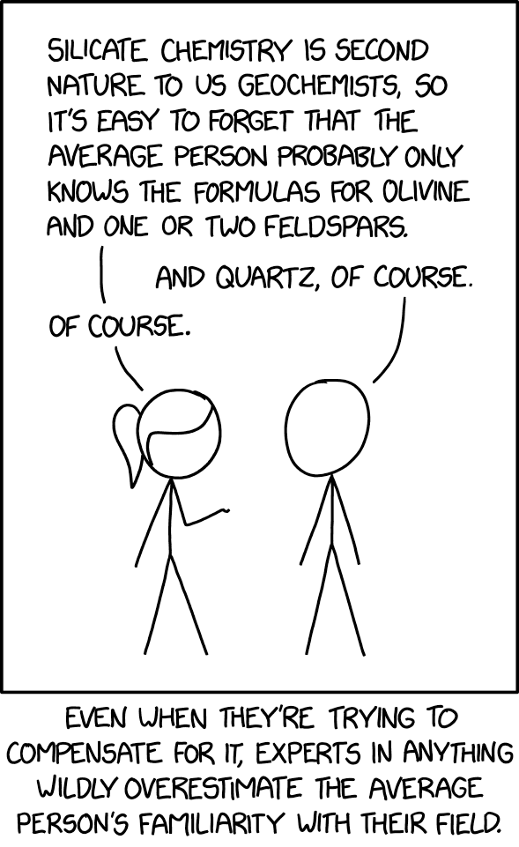
Federated Learning
22-5-2025
Stijn de Boer
A hands-on introduction to federated learning with the PCNtoolkit

Slide 2

About me
MSc. In AI at Radboud University (2022)
Master thesis at the Donders under supervision of prof. Andre Marquand: Non-Gaussian Normative Modelling with Hierarchical Bayesian Regression
Member of the Datadriven Innovation team at the Radboud UMC, which brings together experts on data and AI from different backgrounds
Working on the PCNtoolkit since 2021

Slide 3
Goal of this workshop
Understanding the need for federated learning (FL)
Learn the core concepts and taxonomy
Explore the challenges and solutions
Get hands-on experience with the PCNtoolkit

Slide 4
Understanding the need for federated learning

Slide 5

Data privacy & regulatory landscape
Understanding the need for federated learning
1996 – HIPAA (US)
Regulates the use of protected health information (PHI)
Medical ML research can never expose or transfer PHI
2016 – GDPR (EU)
Restricts processing, storage, and sharing of personal data
Centralized ML often violates GDPR
2018 – CCPA (California US)
Not US-wide, but regulates 40 million Americans and 500.000 businesses
Inspired regulatory action in other states; Nevada, Maine, Conneticut, Washington, New York
2025 – Executive Orders
Large-scale data removal from public institutions (CDC, NIH)
ABCD dataset access tightened – largest long-term US study of brain development
Clear trend → Data can not move, so models will have to: need for FL
Notes:
HIPAA: The Health Insurance Portability and Accountability Act
GDPR: General data protection regulation
CCPA: California Consumer Privacy Act
CDC: Center for Disease Control and Prevention
NIH: National Intitutes of Health ABCD: Adolescent Brain Cognitive Development

Slide 6

Institutional Barriers
Understanding the need for federated learning
Re-identification of datasets is a risk
Ethics boards are reluctant to approve data sharing
Differences in privacy laws create legal deadlocks
Sharing may violate consent boundaries, or consent may expire
Bureaucracy slows things down
Notes:
HIPAA: The Health Insurance Portability and Accountability Act
GDPR: General data protection regulation
CCPA: California Consumer Privacy Act
CDC: Center for Disease Control and Prevention
NIH: National Intitutes of Health ABCD: Adolescent Brain Cognitive Development

Slide 7
Case study: ABCD dataset
Understanding the need for federated learning
Adolescent Brain Cognitive Development study
Largest long term study of child brain development in the US
Started in 2016, aims to follow 12.000 children for 10 years
Includes MRI scans, cognitive testing, genetic data, family background, mental health, substance use, ...
Executive order under the current US administration resulted in:
Removal of thousands of public CDC/NIH websites
Restricted access to behavioral health and adolescent datasets (like ABCD)
Classification of some research areas as politically sensitive (like sexual preference)
Implications
Sudden loss of open data access
New boundaries for data sharing even within the US
Removal of politically sensitive features from new versions of the ABCD dataset
Uncertainty and mistrust about data stability
Notes:
HIPAA: The Health Insurance Portability and Accountability Act
GDPR: General data protection regulation
CCPA: California Consumer Privacy Act
CDC: Center for Disease Control and Prevention
NIH: National Intitutes of Health ABCD: Adolescent Brain Cognitive Development

Slide 8

Why decentralized learning is the way forward
Understanding the need for federated learning
Centralized modelling is failing
Moving data is becoming increasingly slow and risky
Collaboration is stalling
Trust is eroding
FL as a paradigm:
Data stays local → Only models move
Privacy-by-design
Benefits:
Cross-site machine learning
Reduces risk of data breaches
Owners stay in control of their data
Notes:
HIPAA: The Health Insurance Portability and Accountability Act
GDPR: General data protection regulation
CCPA: California Consumer Privacy Act
CDC: Center for Disease Control and Prevention
NIH: National Intitutes of Health ABCD: Adolescent Brain Cognitive Development

Slide 9
What is federated learning?

Slide 10
Core definition and concept
What is federated learning
In general:
The data never leaves the owner
Only model parameters/parameter updates are shared
Centralized or distributed model/parameter aggregation
Guarantees full privacy and ownership
Allows cross-site Machine Learning
Notes:
HIPAA: The Health Insurance Portability and Accountability Act
GDPR: General data protection regulation
CCPA: California Consumer Privacy Act
CDC: Center for Disease Control and Prevention
NIH: National Intitutes of Health ABCD: Adolescent Brain Cognitive Development

Slide 11










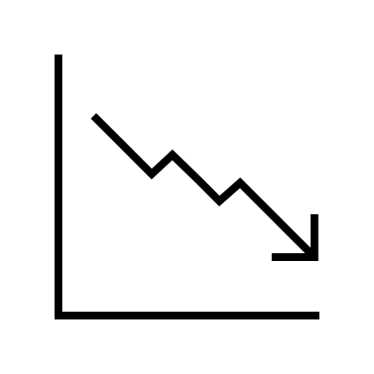

Federated learning in artificial Neural networks
What is federated learning
Idea 1:
Initiate a model
Send model to local node 1 and train
Send model to local node 2 and keep training
Send model to local node 3...
etc.
Notes:
HIPAA: The Health Insurance Portability and Accountability Act
GDPR: General data protection regulation
CCPA: California Consumer Privacy Act
CDC: Center for Disease Control and Prevention
NIH: National Intitutes of Health ABCD: Adolescent Brain Cognitive Development
IID: Independant and Identically Distributed data

Slide 12


Federated learning in artificial Neural networks
What is federated learning
Idea 2:
Initiate a global model
Send parameters to local nodes
Compute loss and gradients on local nodes
Aggregate gradients on global server
Update the parameters
Repeat 2-5 until covergence
Problems:
Requires large bandwidth
Convergence is tricky with non-IID data
Notes:
HIPAA: The Health Insurance Portability and Accountability Act
GDPR: General data protection regulation
CCPA: California Consumer Privacy Act
CDC: Center for Disease Control and Prevention
NIH: National Intitutes of Health ABCD: Adolescent Brain Cognitive Development
IID: Independant and Identically Distributed data

Slide 13
Federated learning: the bayesian approach
What is federated learning
Our approach:
Train models in complete isolation
Centralized or distributed aggregation
Aggregation can be done in one of several ways:
Transfer: take a trained model and modify it so it can be used on a new dataset
Extend: take a trained model and modify it so it can be used on a new AND the original dataset
Merge: take multiple trained models and combine them into one
Notes:
HIPAA: The Health Insurance Portability and Accountability Act
GDPR: General data protection regulation
CCPA: California Consumer Privacy Act
CDC: Center for Disease Control and Prevention
NIH: National Intitutes of Health ABCD: Adolescent Brain Cognitive Development

Slide 14


Taxonomy
What is federated learning
Transfer
Extend
Merge
Notes:
HIPAA: The Health Insurance Portability and Accountability Act
GDPR: General data protection regulation
CCPA: California Consumer Privacy Act
CDC: Center for Disease Control and Prevention
NIH: National Intitutes of Health ABCD: Adolescent Brain Cognitive Development

